Slide 1

Analysis of Fatal Crash Data - Australia
1989-2020
1
Interesting Questions
2
Information about the Data
3
Data Exploration and Clean Up Process
4
The Analysis Process
5
Conclusions
6
Implications

Slide 2
Questions?
How has the rate of road fatalities trended over time?
Are there any factors that increase the risk of crash fatalities?
Areas to consider:
^{time}
^{geographic}
^{demographic}
^{road usage}

Slide 3

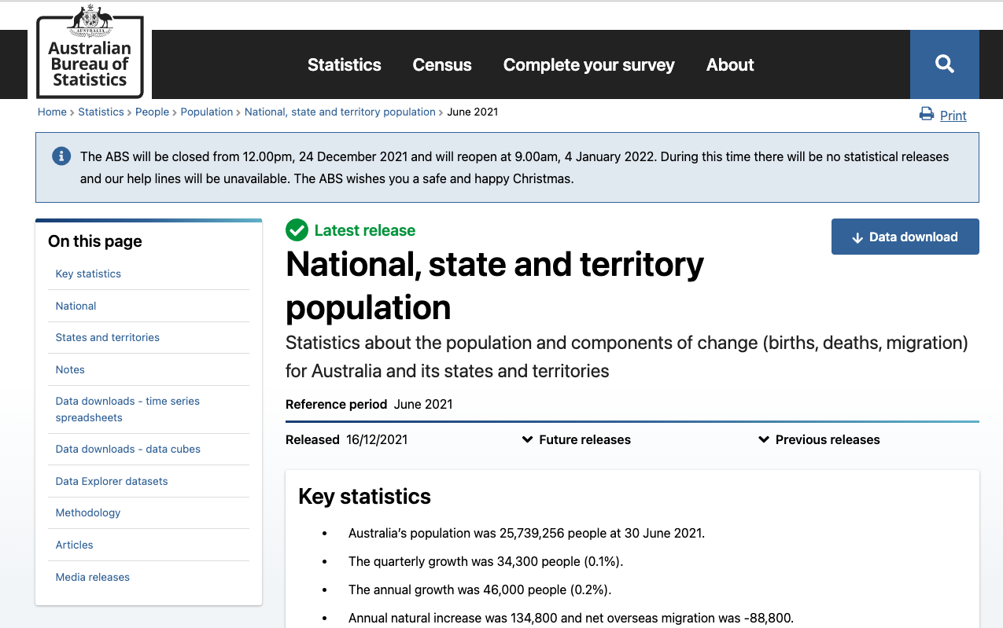
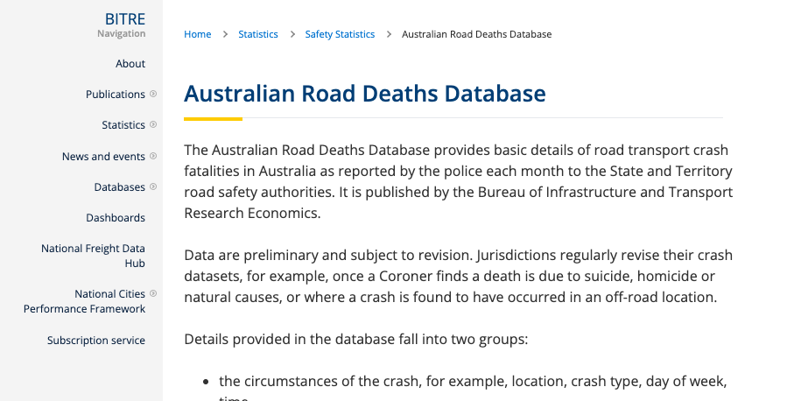

The Data
Australian Road Deaths
State Population Date
Bureau of Infrastructure, Transport, Regional Development and Communication
Australian Bureau of Statistics

Slide 4
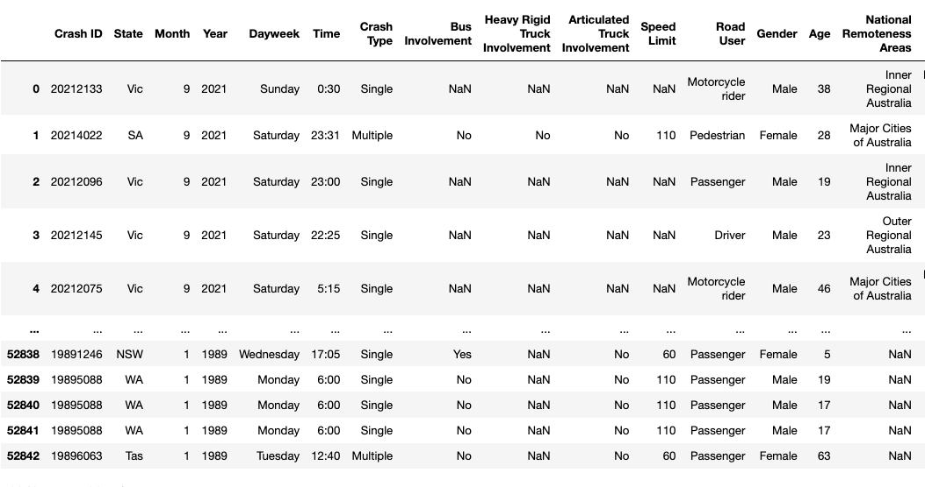
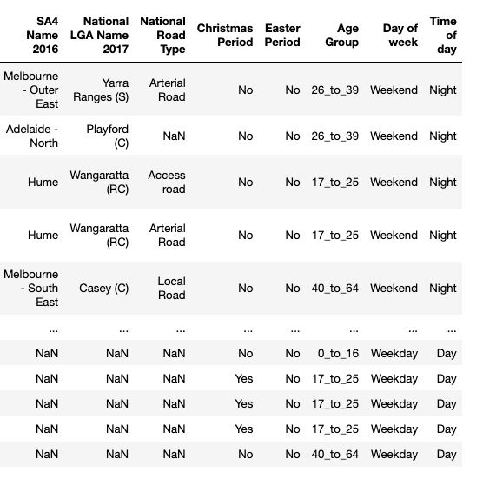
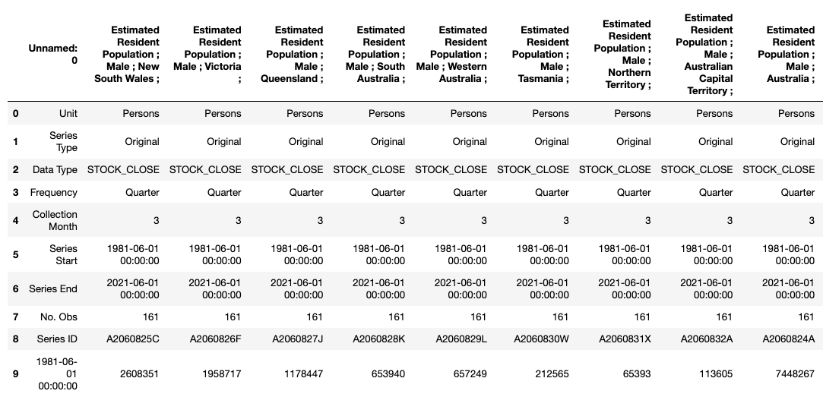
The Data continued…
Crash Data
Shape (52843,23)
Population
Notes:
The crash dataset was based on incident. The population dataset was based on 3-month periods with extraneous data in the top rows. It was segmented into columns by state and sex. A lot of cleaning had to occur to join the two.

Slide 5
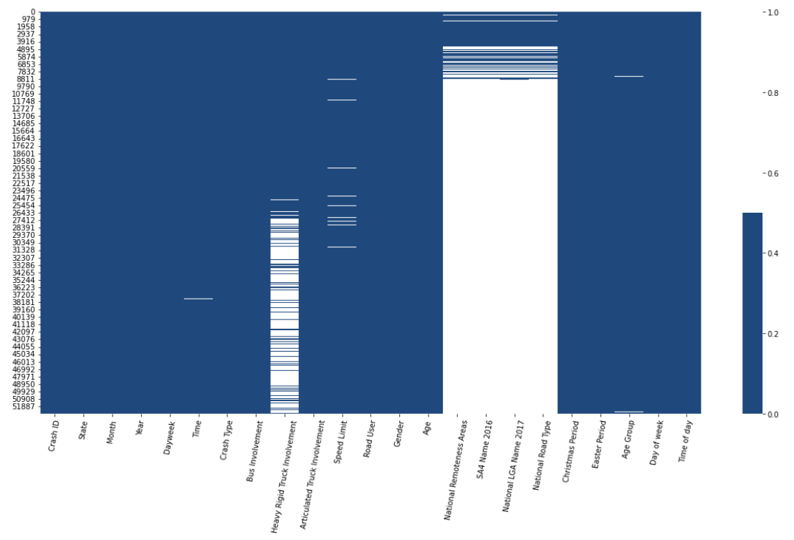
Data Exploration
Columns | % Missing
Crash ID | 0
State | 0
Month | 0
Year | 0
Dayweek | 0
Time | 0
Crash Type | 0
Bus Involvement | 0
Heavy Rigid Truck Involvement | 39
Articulated Truck Involvement | 0
Speed Limit | 1
Road User | 0
Gender | 0
Age | 0
National Remoteness Areas | 87
SA4 Name 2016 | 87
National LGA Name 2017 | 87
National Road Type | 87
Christmas Period | 0
Easter Period | 0
Age Group | 0
Day of Week | 0
Time of Week | 0
Notes:
We plotted the empty to understand what was missing. We found that certain columns were added over time. Knowing this, we could reduce the timeframe based on the periods for which the data was collected – if we wanted to glean information from those new fields.

Slide 6

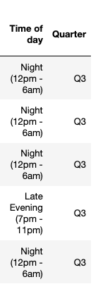
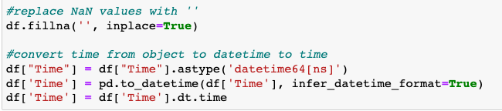
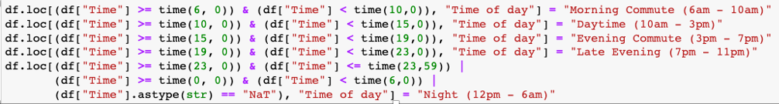
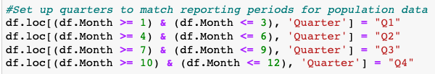
Cleaning (Crash Dataset)
Formatting Time
Adding Time of day
Adding Quarter
Notes:
Crash dataset was fairly clean and useable. We just needed to remove NaN values and convert time to format that could be compared.
The quarters were added so the population dataset could be merged based on state/year/quarter because that’s how the population data was collected.

Slide 7
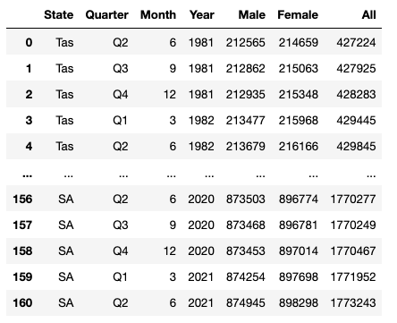
Cleaning (Population Dataset)
1
Rename Column Headers
2
Set columns to numeric
4
Retrieve Month and Year from Date
5
Create a Quarters Column
6
Create new DataFrame for each state with new columns
7
Combine into one DataFrame

Slide 8
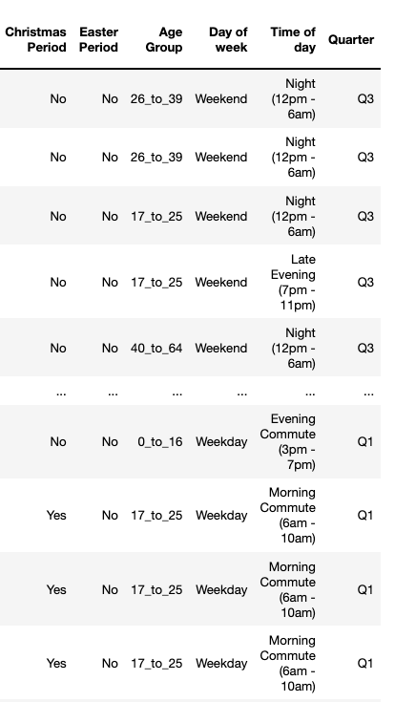
Merging Datasets
State - Year - Quarter

Slide 9
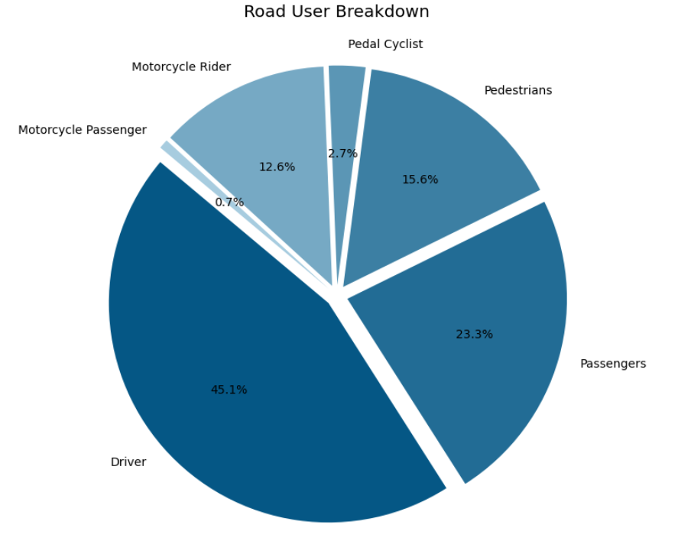
Summary of Data
Number of Accidents | 47,322
Total Fatalities | 52,566
% Female | 28
% Male | 72
Average Age | 40
Average Speed Limit | 82

Slide 10
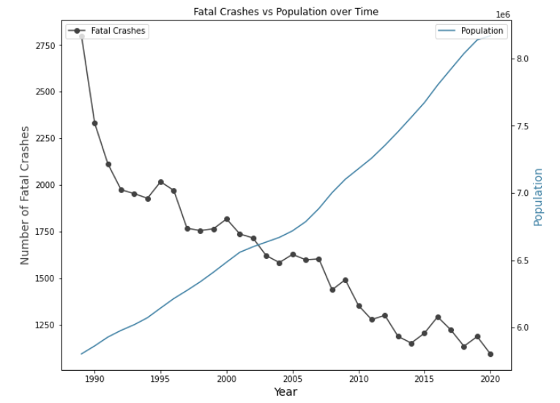
Time vs Fatalities Correlation - Australia
How has the fatality rate trended over time?
Conclusion:
Fatality rate and
time are negatively
correlated
-0.92

Slide 11
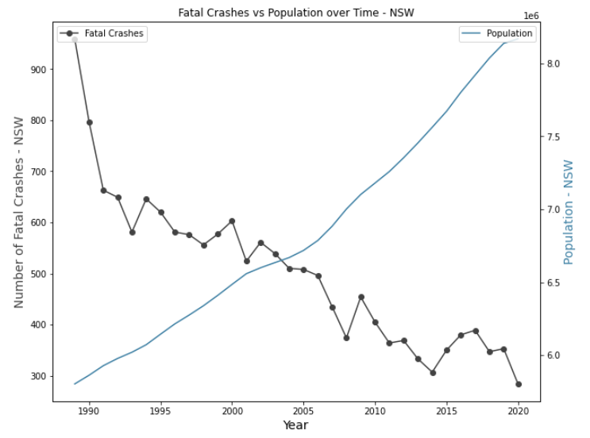
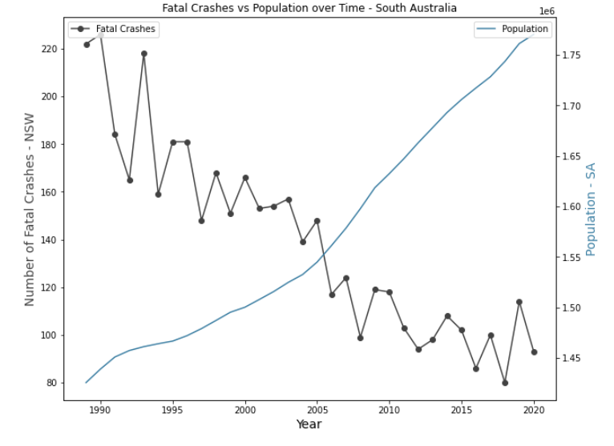
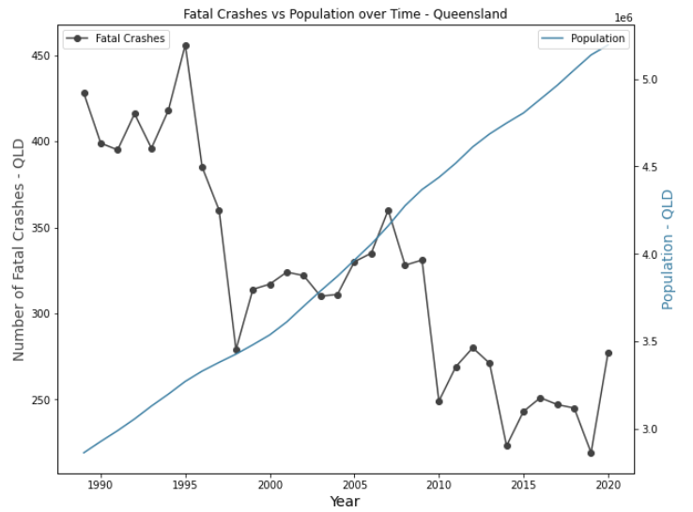
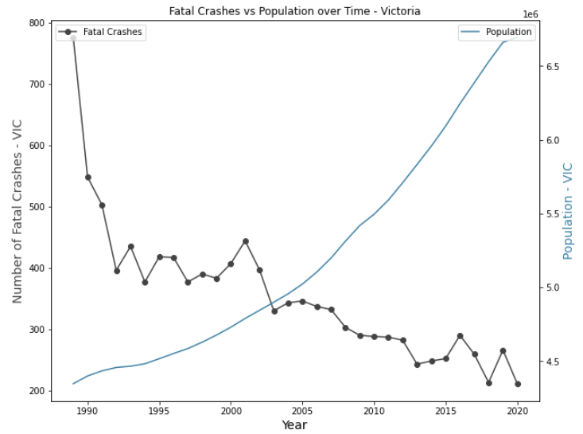
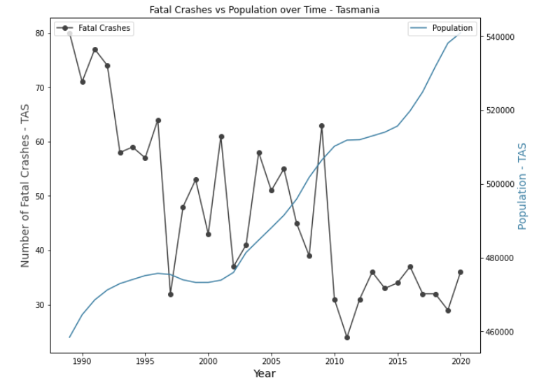
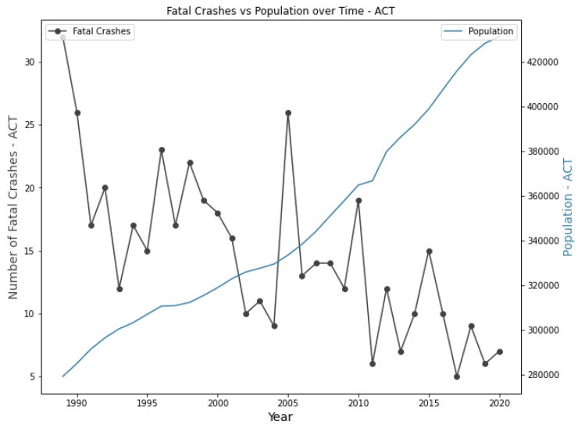
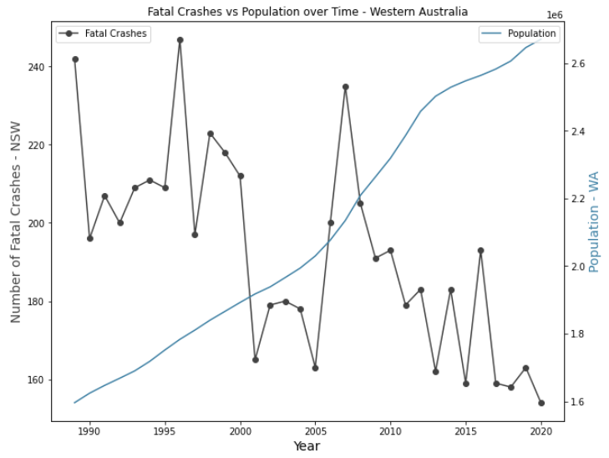
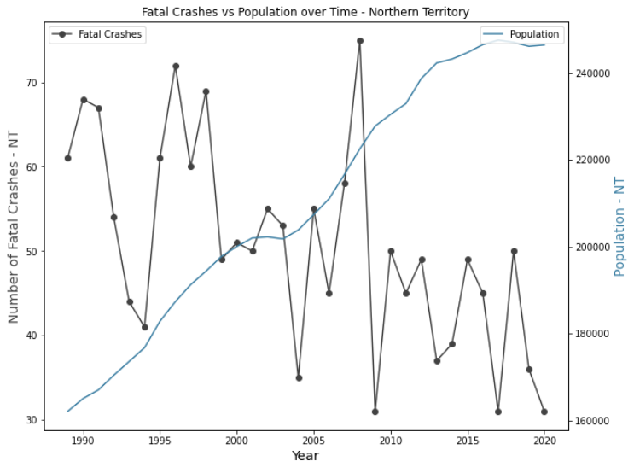
Time vs Fatalities Correlation – by State
How has the fatality rate trended over time per state?
NSW
SA
QLD
VIC
-0.89
-0.89
-0.86
-0.77
TAS
ACT
WA
NT
-0.74
-0.71
-0.67
-0.57
Conclusion: Per state, fatality rate and time are negatively correlated but vary in degree

Slide 12
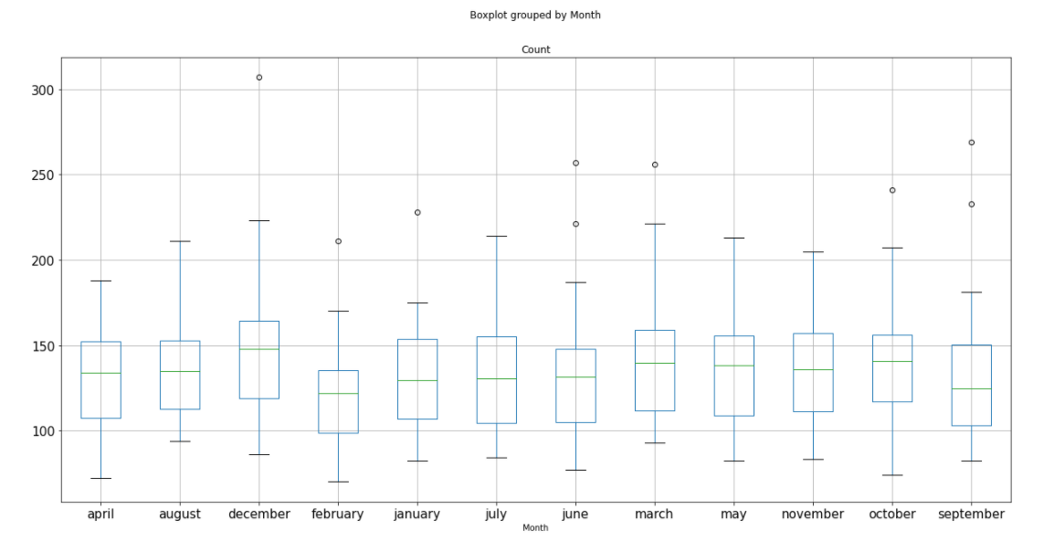
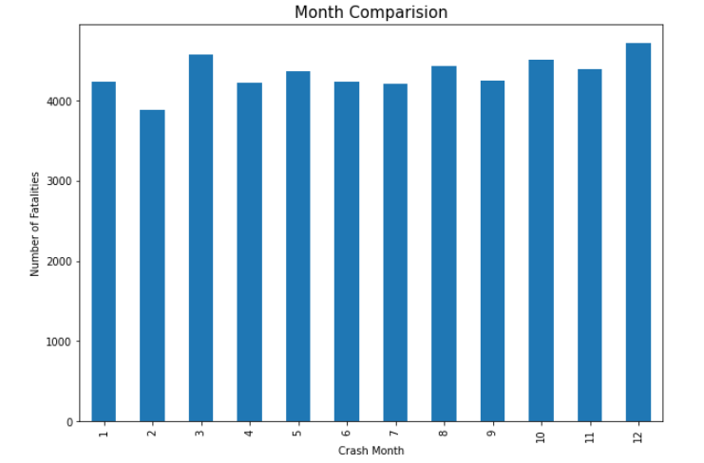
Time: Month
Is there correlation between month and number of fatalities?
P-value = 0.29948876
Conclusion: Not statistically significant
Notes:
The P-Value on the array showed no significant statistical difference between the months. However,

Slide 13
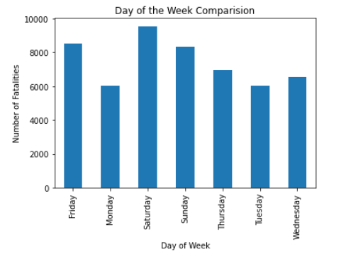
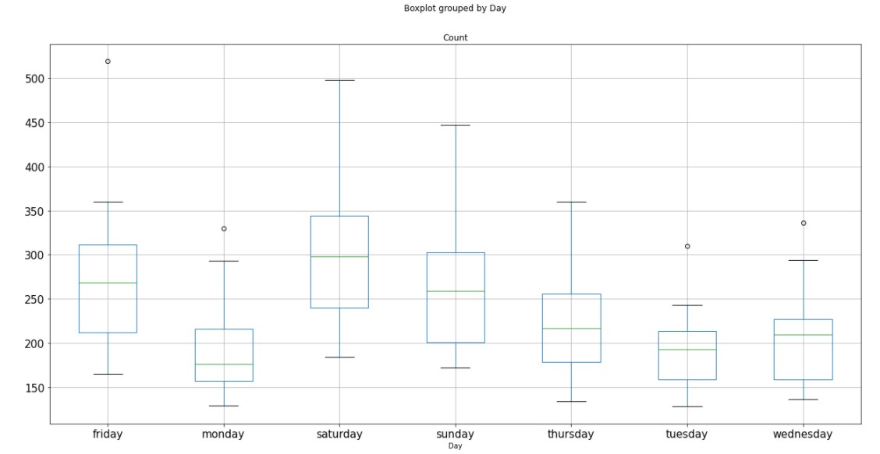
Time: Day of the Week
Is there a correlation between day of the week and number of fatalities?
P-value = 1.025e-15
Conclusion: Statistically Significant

Slide 14
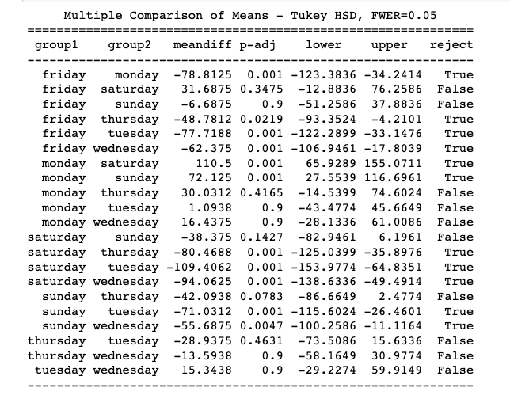
Time: Week Comparison continued
Statistically Significant >
Saturday
Friday
Sunday

Slide 15
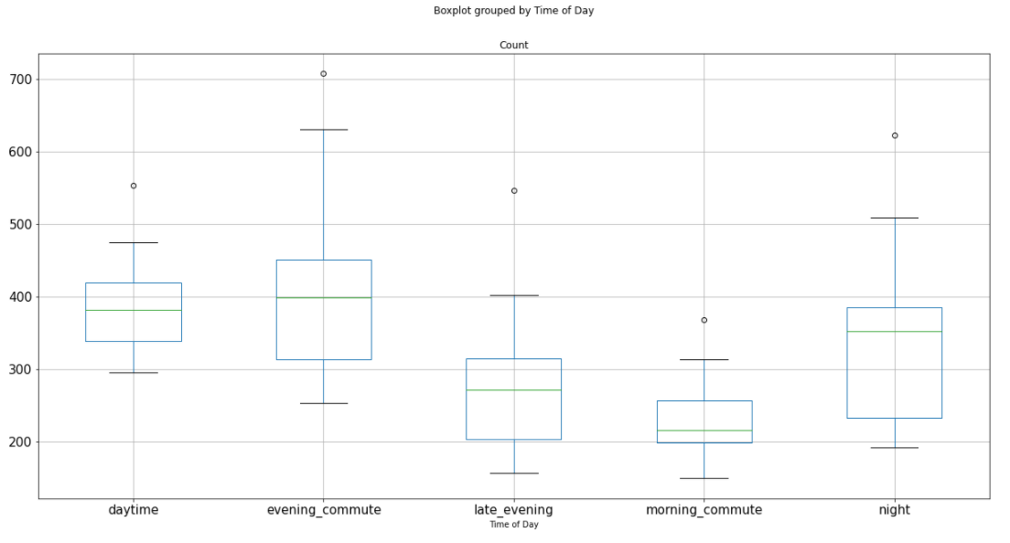
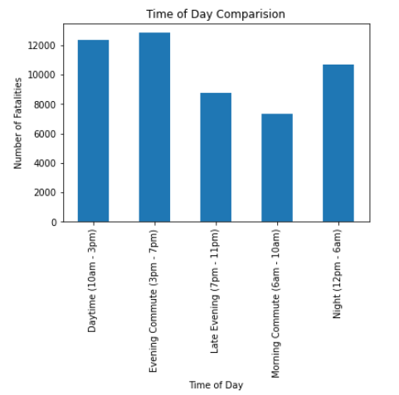
Time: Day of the Week
Is there correlation between day of the week and number of fatalities?
P-value = 1.0527e-15
Conclusion: Statistically Significant

Slide 16
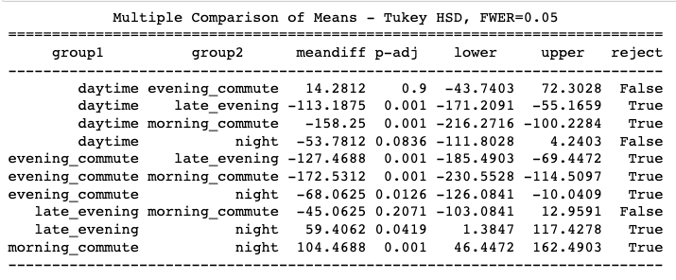
Time: Time of Day Comparison continued
Statistically Significant >
Evening Commute
Daytime
Night

Slide 17
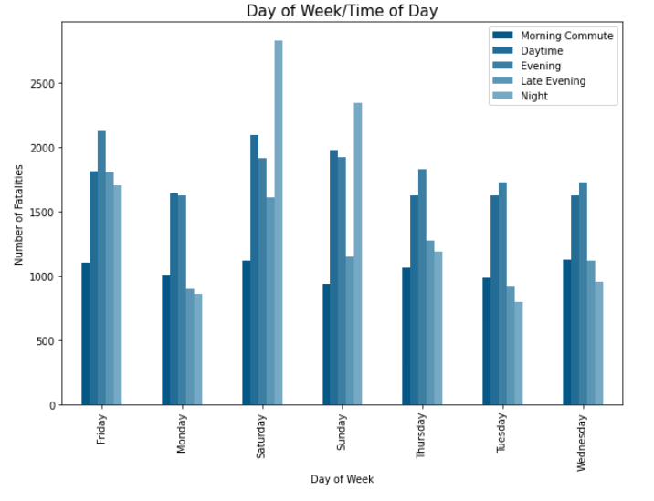
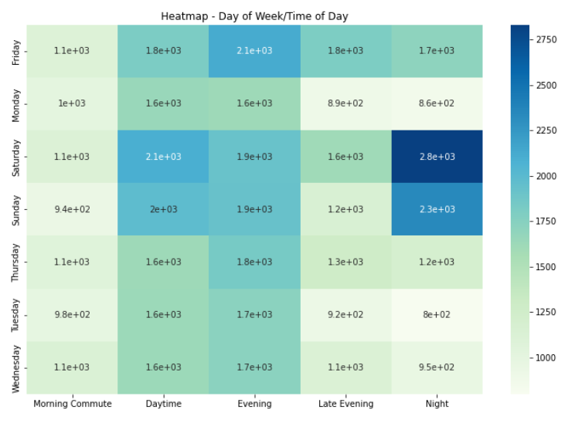
Time: Day of the Week and Time of Day
Conclusion: Crash time of day varies based on day of week

Slide 18



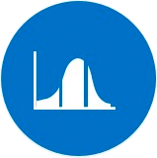

Implication: Time Matters
Intervention, whether legislation, safety parameters or other measures seem to have significantly impacted the rate of car crash fatalities since 1989.
There has not been a statistically significant increase in fatal crashes around major holidays (Christmas and Easter), or any particular month.
Time of day matters as well. Overall, evenings have a statistically significant increase in number of fatal crashes.
There is a statistically significant increase in fatal crashes on Saturday, Friday and Sunday, respectively.
Fatal crashes occurring at night are more common on Saturday and Sunday.

Slide 19
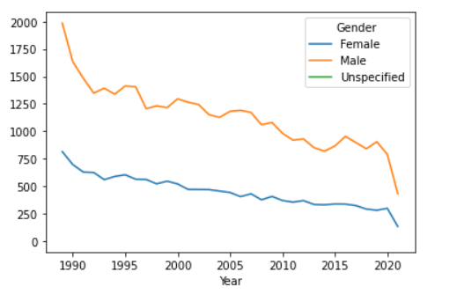
Demographic View: Gender

Slide 20
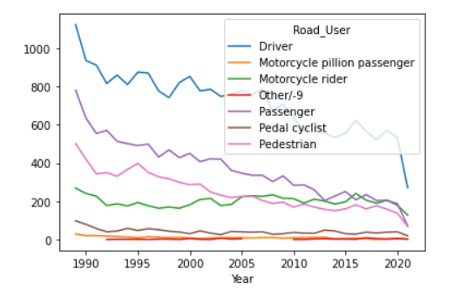
Demographic View: Road User Type
Insert table and comments here

Slide 21
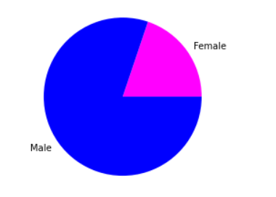
Demographic View: Gender – Total Observations
Insert table and comments here

Slide 22
Demographic View: Gender – All Accidents
(Driver, Motorcyclist, Bicyclist only)
Insert table and comments here

Slide 23
Demographic View: Gender – Single Vehicle Accidents
(Driver, Motorcyclist, Bicyclist only)
Insert table and comments here

Slide 24
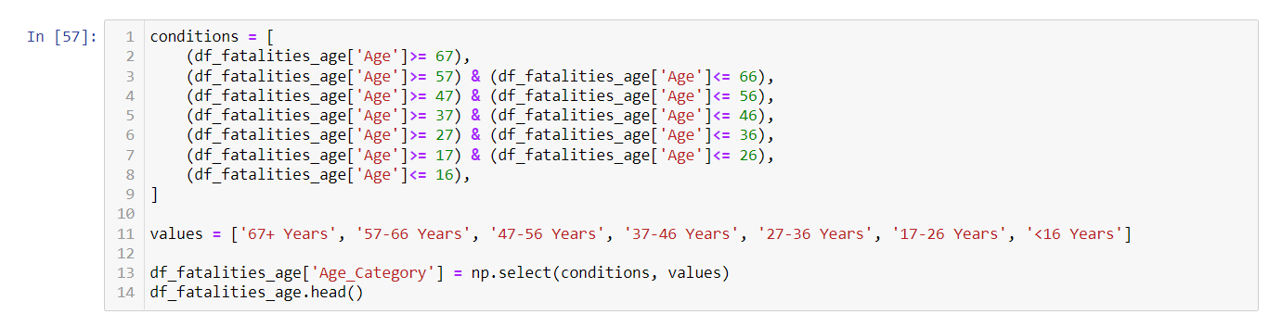
Demographic View: Age Distribution – Overall – Age Grouping
1
Create Column Header
Insert table and comments here
2
Set Conditional Formatting
4
Set Values

Slide 25
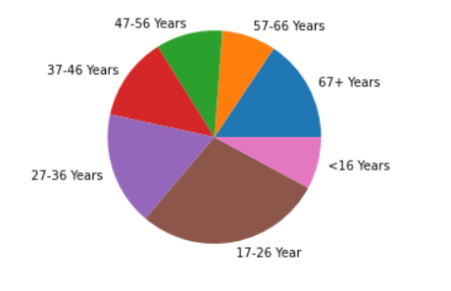
Demographic View: Age Distribution - Overall
Insert table and comments here

Slide 26
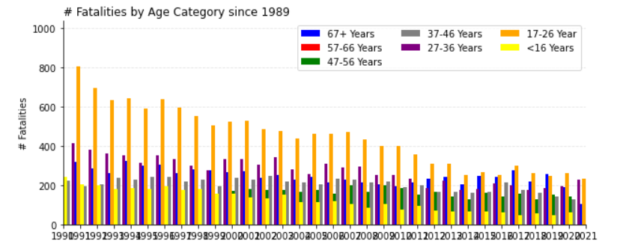
Demographic View: Age Distribution - Overall
Insert table and comments here

Slide 28
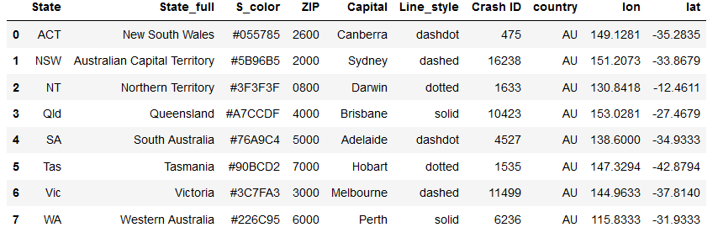
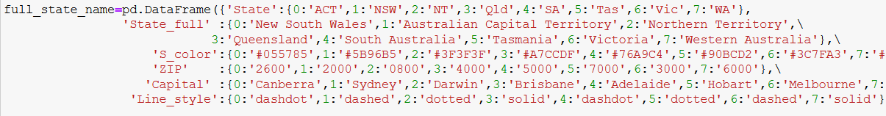
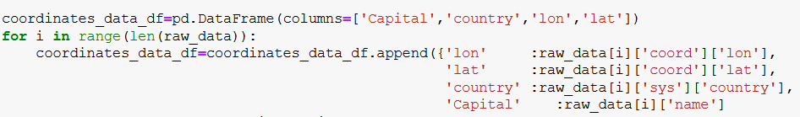
Initialize Variable (DataFrame)
Initialize Variable (States, color, line style, etc..)
Adding Coordinates

Slide 29
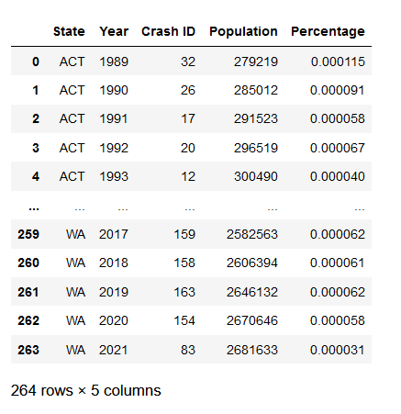
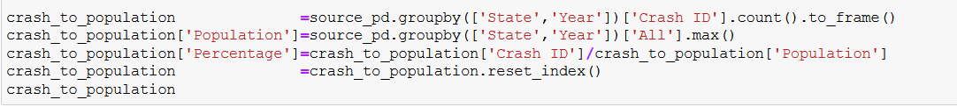
Calculating Crash to Population Ratio
Pandas Calculation

Slide 30
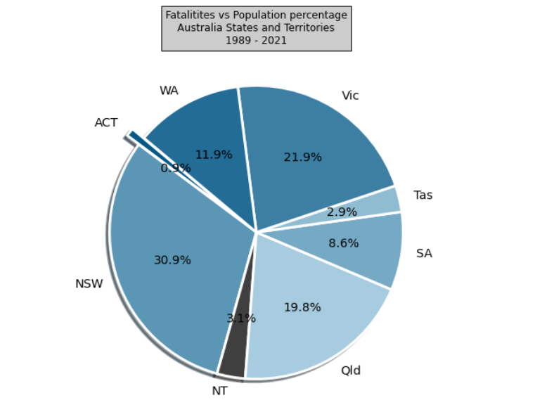
State vs Fatalities
ACT | 475
NSW | 16,238
NT | 1633
QLD | 10,423
SA | 4527
TAS | 1535
VIC | 11,499
WA | 6236

Slide 31
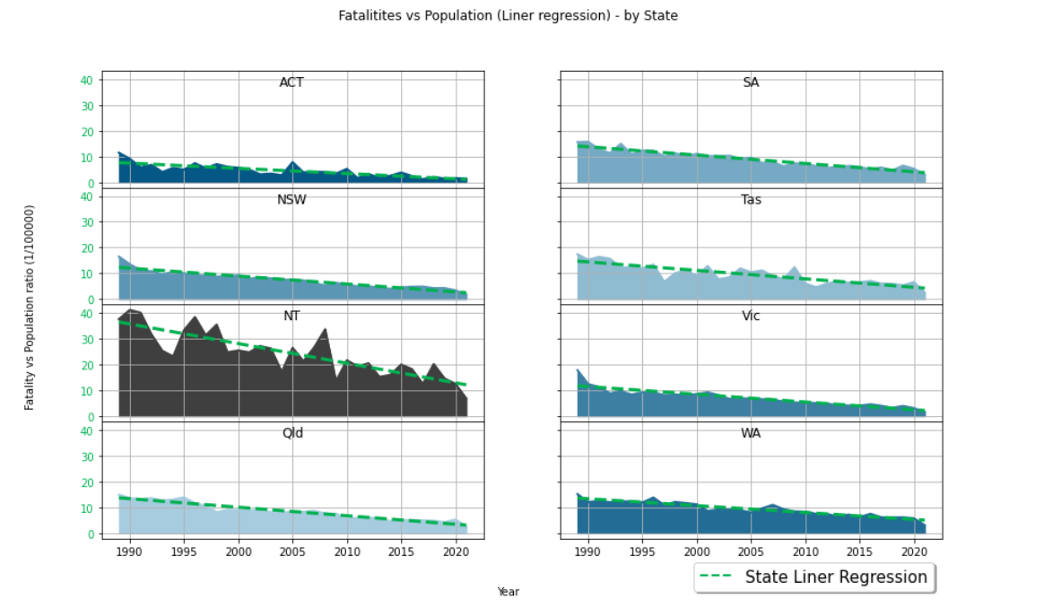
Fatalities vs Population (Liner regression) – by State

Slide 32
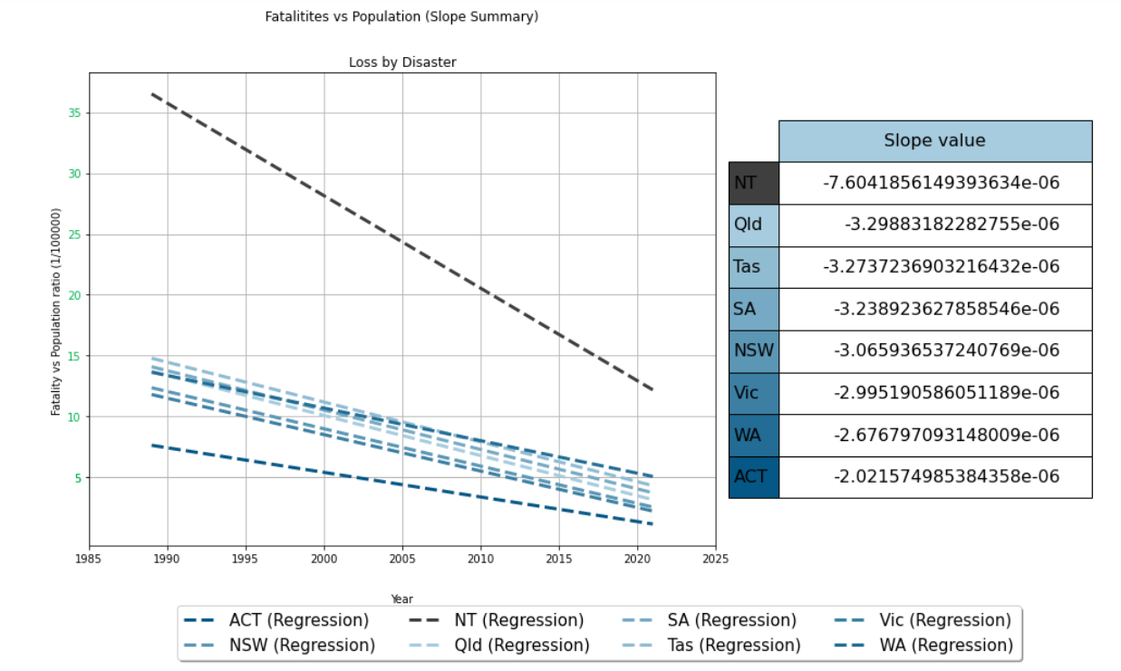
Significant decrease

Slide 33
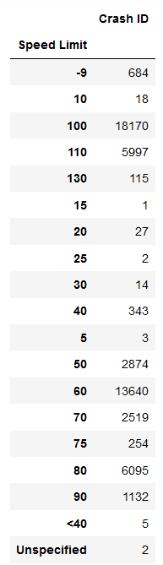
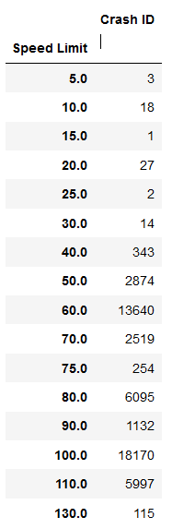
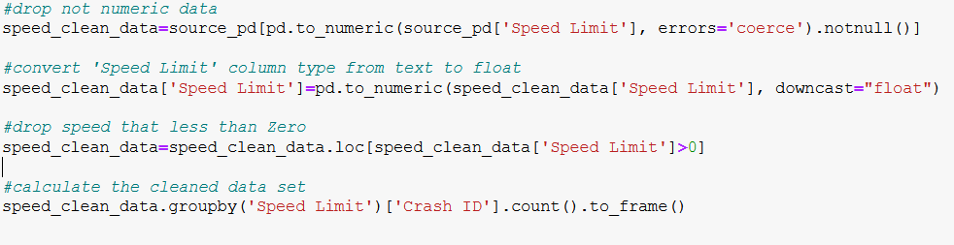
Cleaning (Speed Limit data)
Cleaning non numerical values
Adding Time of day

Slide 34

Speed vs Fatalities - Australia

Slide 35

Speed vs Fatalities (Correlation) - Australia

Slide 36
Implication: Speed and State Matters
Line regression slop value for fatal crashes over time based on state was Negative (decrease) towards zero.
Norther territory recorded the highest significant decrease while
Australian Capital Territory recoded the most minor decrease in crash fatality
Correlation factor between Speed and crash fatality is between medium correlation into strong correlation, no single state recorded no correlation or small correlation

